Slide 1


DESIGN 1
Lesson 2: Platform & Login Setup
Ms. Abboud | Grade 9 - Design 1 | Term 1, Week 1

Slide 2
Learning Objectives
WALT - We Are Learning To
WILF - What I'm Looking For
To successfully log into my laptop and every platform needed for Design 1.
To set up an organized file-saving system for this term.
I am logged into my laptop and the school network.
I am logged into Toddle and can see the Design 1 class.
My code editor is installed and working.
My Hello World file is saved and opens correctly in a browser.

Slide 3
Academic Vocabulary
Code Editor
File Extension
A program used to write and save code (like VS Code or Notepad). It doesn't add hidden formatting the way a word processor does.
The letters after the dot in a filename (like .html) that tell the computer what kind of file it is.

Slide 4
Frayer Model: Code Editor
DEFINITION
CHARACTERISTICS
A program used to write and save code (for example VS Code or Notepad), different from a word processor because it doesn't add hidden formatting.
Highlights code by color. Shows line numbers. No hidden formatting.
CODE EDITOR
EXAMPLES
NON-EXAMPLES
VS Code. Notepad. Sublime Text.
Microsoft Word. A web browser.

Slide 5
National Identity Integration
UAE Digital Transformation and Future Skills: as you learn to build for the web this term, you're practicing exactly the kind of digital skill the UAE is investing in as it builds a future economy powered by technology and innovation.

Slide 6
STARTER
Quick show of hands: who has written any HTML or code before?
Let's see where the room is at.
Hook - Engage & Ask
5 - 10 minutes

Slide 7
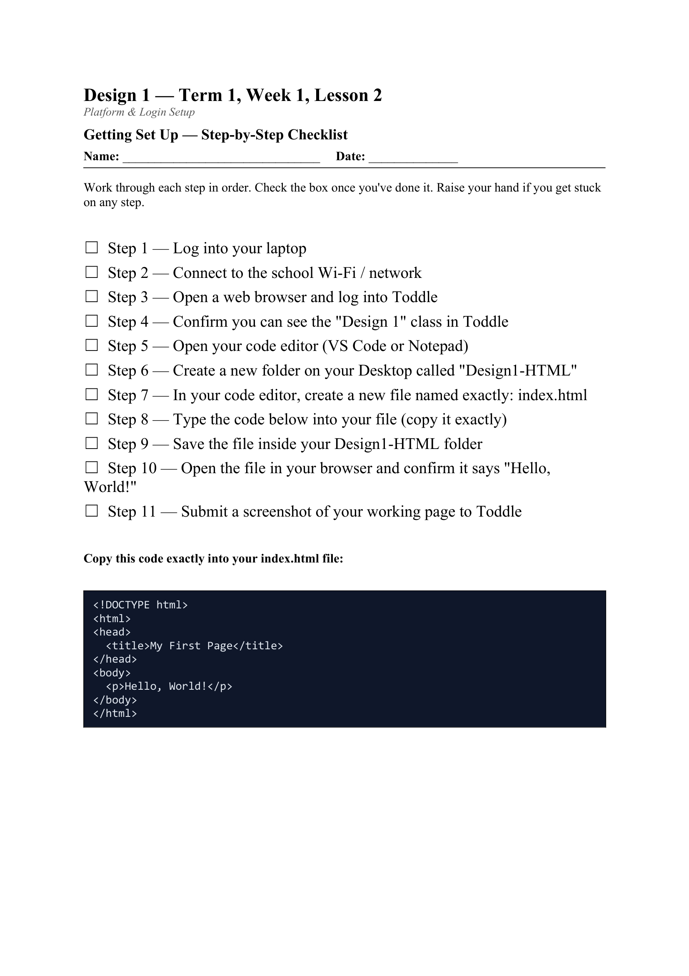
LESSON CORE
Getting Connected
Log into your laptop and check the school network.
Log into Toddle and confirm you can see the Design 1 class.
Gradual Release of Responsibility
30 - 40 minutes
1 / 3
Today's activity: the Platform Setup Checklist

Slide 8
LESSON CORE
Setting Up Your Tools
Locate and verify your code editor (VS Code or Notepad).
Set up a class folder on your desktop or OneDrive, for example Design1-HTML.
File naming rules: no spaces, all lowercase, correct .html extension.
Gradual Release of Responsibility
30 - 40 minutes
2 / 3

Slide 9
LESSON CORE
Hello World Test
Create a file called index.html with a title and the text "Hello, World!"
Save it in your folder, then open it in a browser to check it works.
Gradual Release of Responsibility
30 - 40 minutes
3 / 3

Slide 10
CLOSURE
Submit your Hello World screenshot or file link on Toddle.
This becomes your entry ticket for Lesson 3.
Transition & Extend
5 - 10 minutes

